Slide 1

Cars WebScrapping IN ACTION

Slide 2

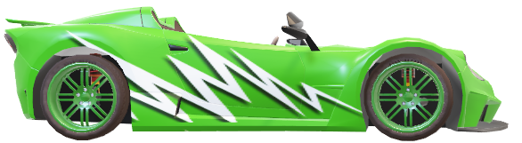
EVOASTRA VENTURES
Evoastra ventures is a company specializing in data science and ai services, offering customized solutions, ai strategy consulting, and machine learning model development.
Founded by Aniket Manwatkar and Syeda Mariya Quadri in 2023.
Evoastra has completed over 356 projects and serves more than 16 brands and organizations.

Slide 3
PROJECT
CARS24 is a leading AutoTech company streamlining and revolutionizing the sale, purchase, and financing of pre-owned cars in India, Australia, Thailand, and UAE founded in 2015.
Leveraging a Smart Al Pricing Engine, and 140 quality checks, selling and buying pre-owned vehicles is seamless and transparent with CARS24.
OBJECTIVE
To scrape detailed car listings from Cars24.com to build a comprehensive dataset for analysis.
DATA TO COLLECT
Make- Model
Kilometers Driven
Year of Manufacture
Fuel Type
Transmission
Location- Price

Slide 4
WEB SCRAPPING
To scrape detailed car listings from cars24.com, capturing various attributes including car name, year of registration, kilometers driven, fuel type, transmission type, discount price, actual price, discount offered, model, and test drive location.
Tools and Technologies Scrapped Details
Python Car brand (Maruti) Selenium Model (Alto ....)
BeautifulSoup Registered year (2016) Km driven (97,698KM)
Edge WebDriver Fuel type (petrol)
Pandas Transmission type (Manual)
Jupyter notebook

Slide 5
Scrapping Challenges and Solutions Intial Scrapping Attempt : Issue: Only 20 entries retrived due to dynamic content loading via javascript. Diagnosis: Disabling Javascript showed limited data visibility,confirming dynamic loading. Switch to Selenium : Reason:To manage dynamic content and javascript updates. Approach: Implemented automated scrolling and page refreshing to load all entries. .

Slide 6
CHALLENGES Dynamic Content Loading : Used selenium to automate scrolling and reload pages to capute all dynamically loaded data Extracting Multiple Data Points : Created targeted extraction steps for different data scattered throughout the HTML Synchronization issues : Added delays and page refreshes to ensure content was fully loaded before extraction

Slide 7
DATA CLEANING
Clean a car sales dataset with columns like "Km driven","Offer price","Original price", focusing on missing values, data type conversions and format standardization.
Tools and Technologies
Python
Pandas
Numpy
Matplot
Steps :
Loaded the data
Created and Applied cleaning functions
Handled missing values
Saved the cleaned data

Slide 8
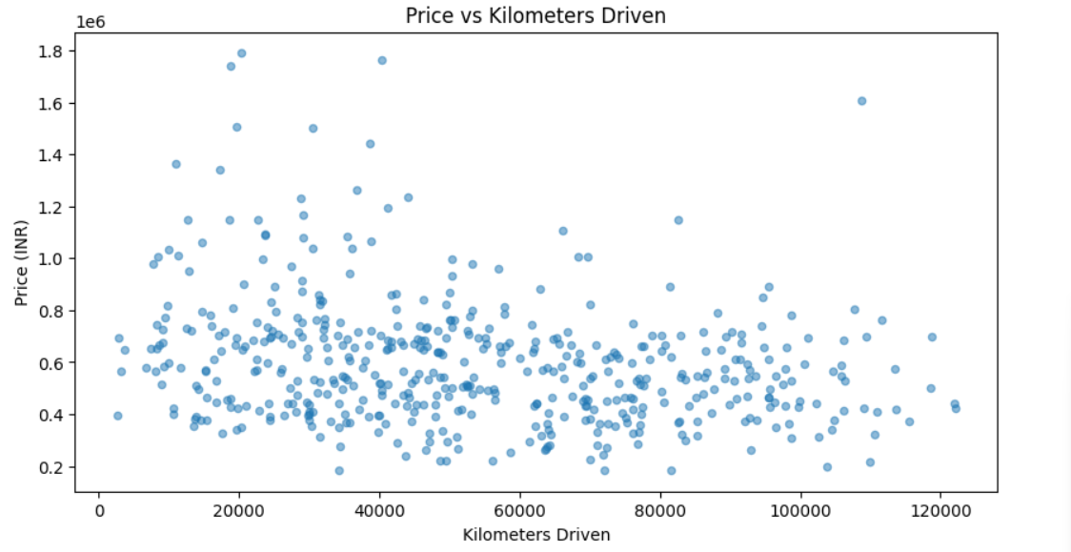
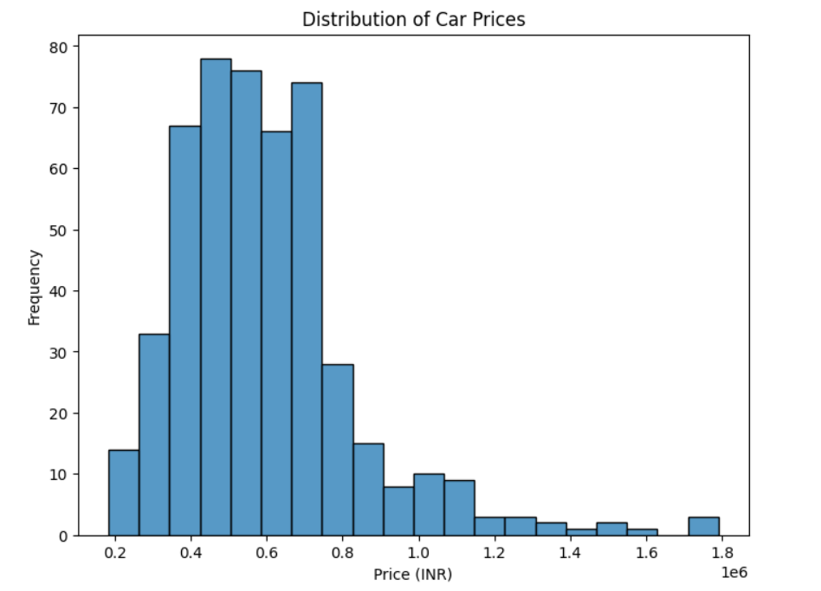
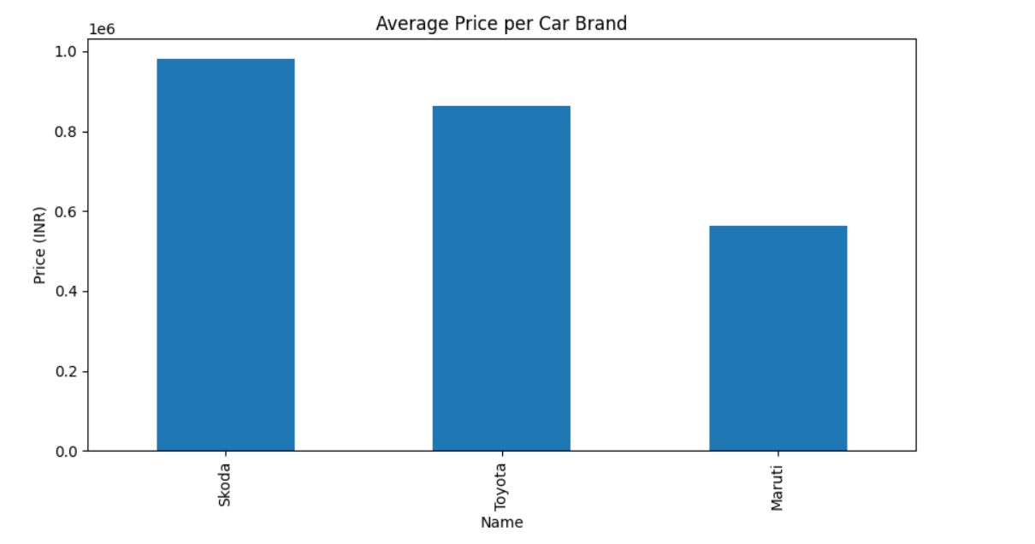
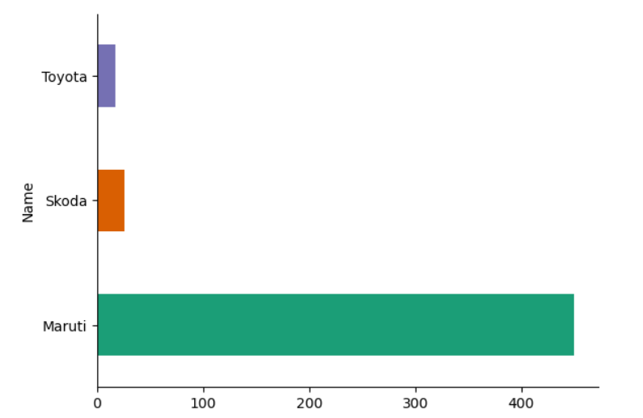

Slide 9
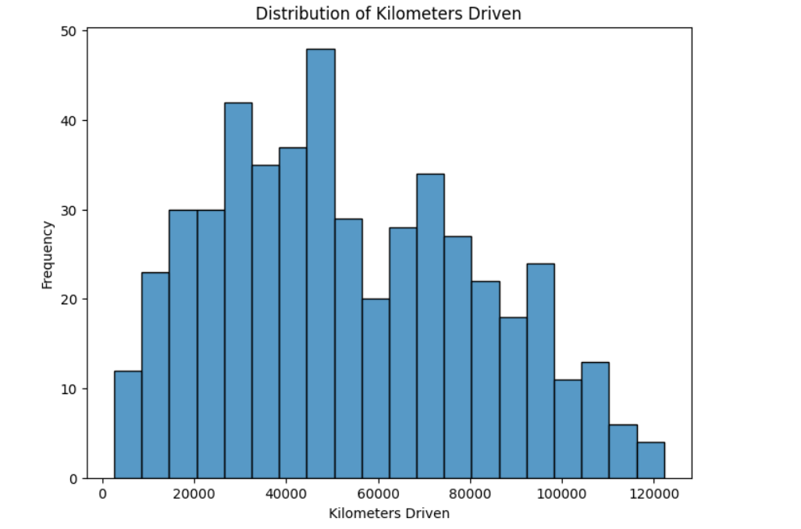
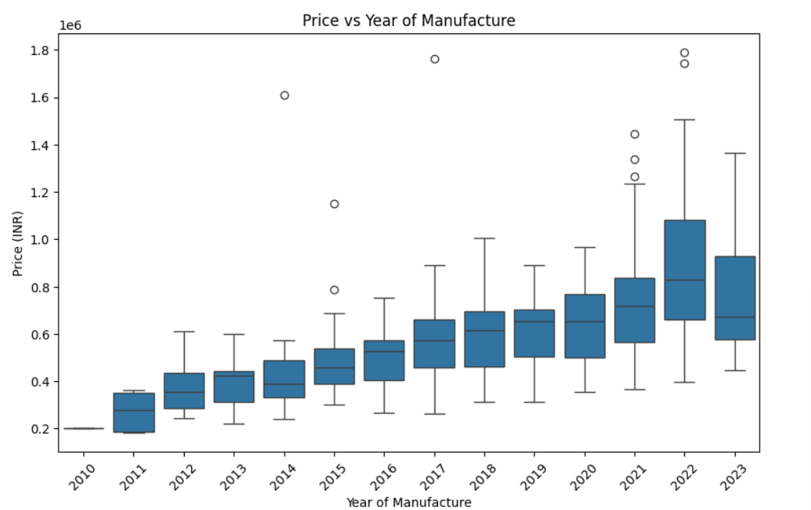
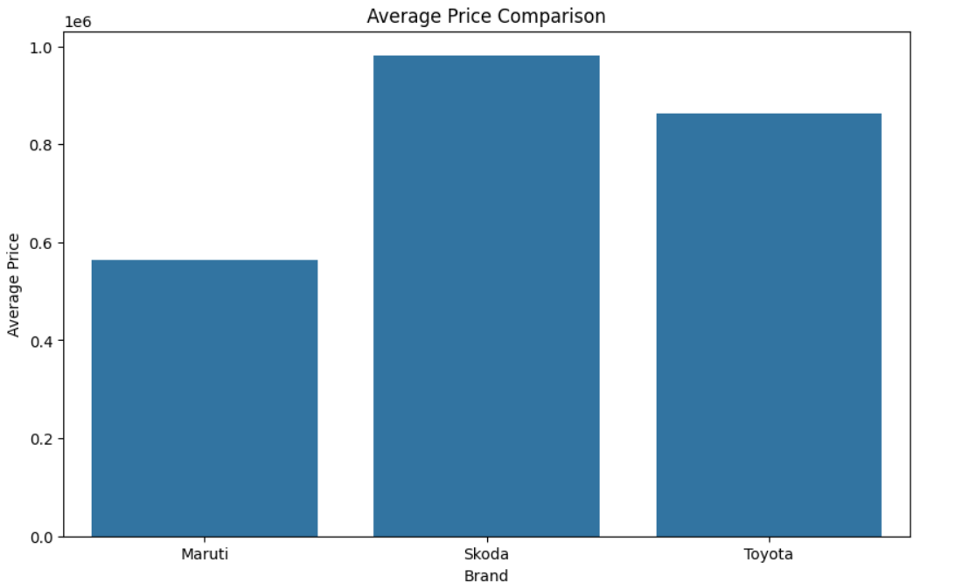
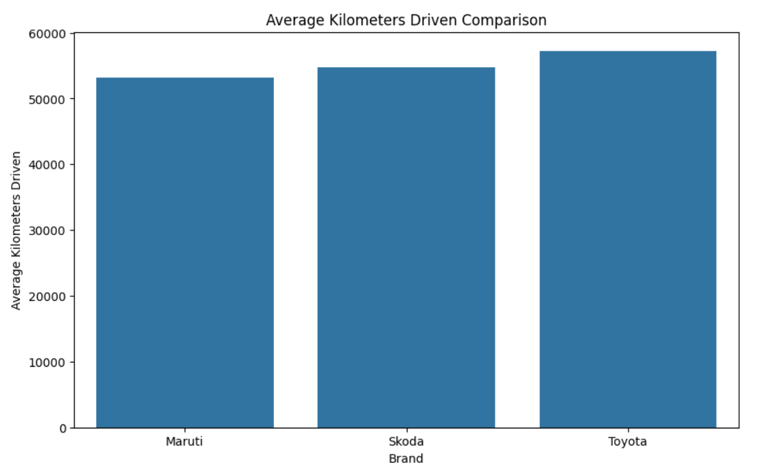

Slide 10
INSIGHTS
There appears to be a negative correlation between price and kilometers driven, indicating that cars with higher mileage tend to have lower prices.
The distribution of car prices is skewed towards lower values, suggesting that a majority of cars are priced lower.
The distribution of kilometers driven also shows a tendency towards lower values.
There is a general trend of higher prices for cars manufactured in more recent years.
Maruti appears to have the lowest average price compared to Skoda and Toyota.
Skoda has the highest average price.
There isn't a significant difference in average kilometers driven between the three brands.

Slide 11
CONCLUSION
Scraped and analyzed car listing from cars24.com to build comprehensive data.
Extracted key data points : Car name, Model, Kilometers driven, Fuel type, Transmission type, Location, etc.
Gained insights into market trends through data analysis.
Ensured data accuracy with cleaning and preprocessing.
Utilized Power BI for effective data visualization and presented actionable insights.
Demonstrated the value of data-driven analysis in uncovering trends and informing business strategies in the automotive sector

Slide 12
